Slide 1
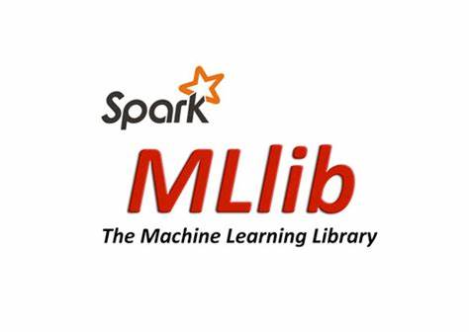




Capstone Project-02
Data Enginnering
Aman Kumar
Axis Batch 05

Slide 2

Tasks
Develop a PySpark application to load data Spark DataFrames and save it into Hive tables on a Hadoop cluster in an optimized format
PART-01
PART-02
Perform profiling of the data through PySpark and ensure that it is migrated correctly whereever the source is an RDBMS
PART-03
Write PySpark routines to cleanse the data, prepare the data to handle missing values, and the data transformations identified in task
If the predictive model identified in task 4 available in Spark MLlib then develop a PySpark application to implement and evaluate the ML model identified
PART-04

Slide 3

Apache Spark supports python,scala,R programming language. PySpark has been released in order to support the collaboration of Apache Spark and Python, it actually is a Python API for Spark

Slide 4
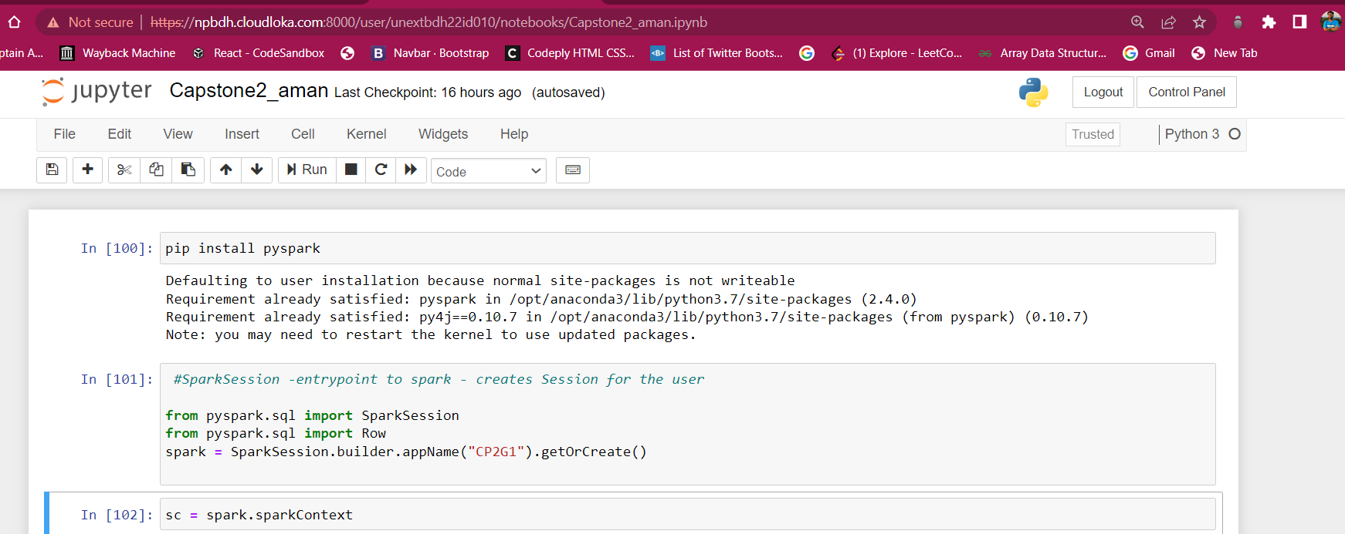
Installing PySpark and creating a Spark Session
Notes:
更多精美PPT模板下载：
http://so.ooopic.com/sousuo/15770370/

Slide 5
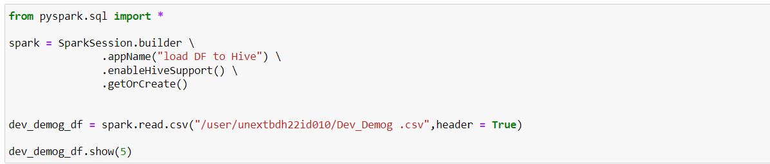
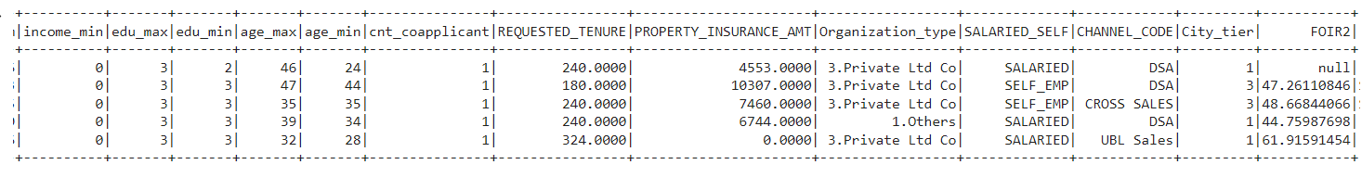
Importing Demog.csv into PySpark and reading file

Slide 6
Data Pipeline
Reading the DataFile using Apache Spark
01
Create Dataframe
& applying Schema on dataframe
02
Doing suitable transformations
03
Writing to Hive table
04

Slide 7
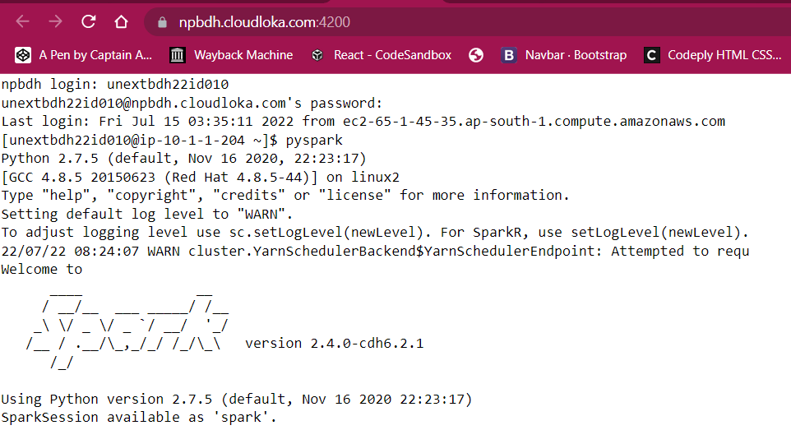
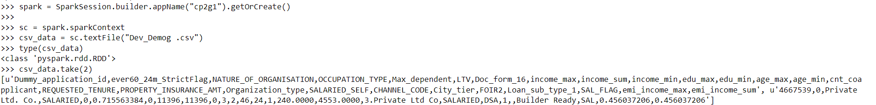
Switching to PySpark in Web Shell and Importing Demog dataset

Slide 8
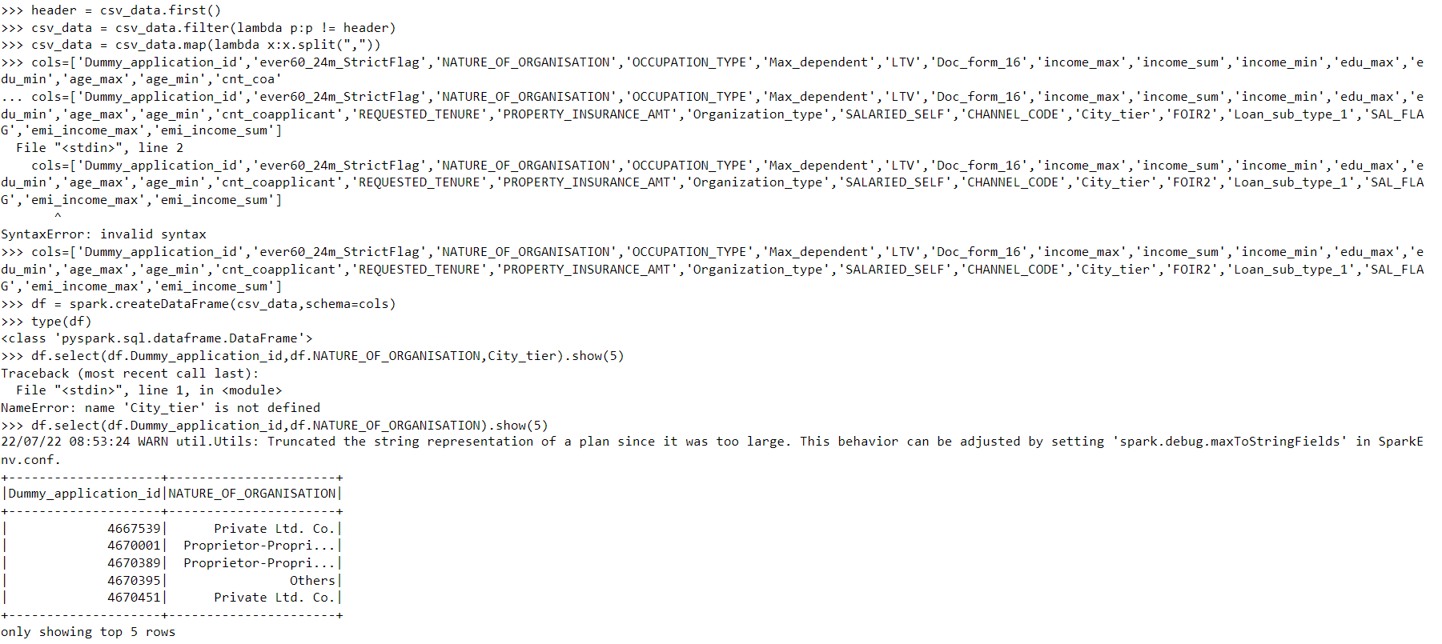
Creating the PySpark Data Frame

Slide 9
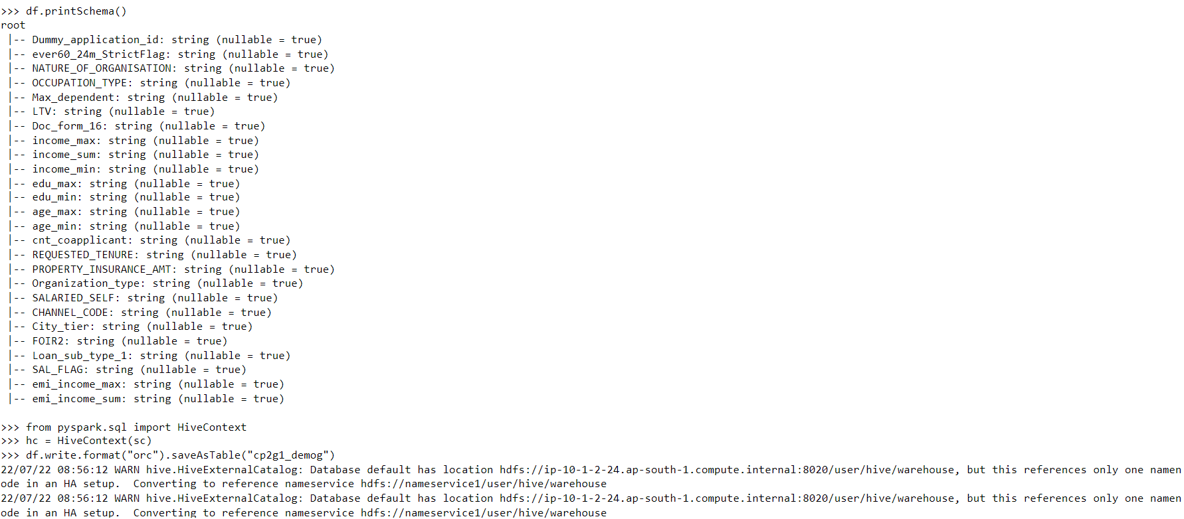
Printing the Schema and saving from Pyspark to Hive on Hadoop cluster

Slide 10
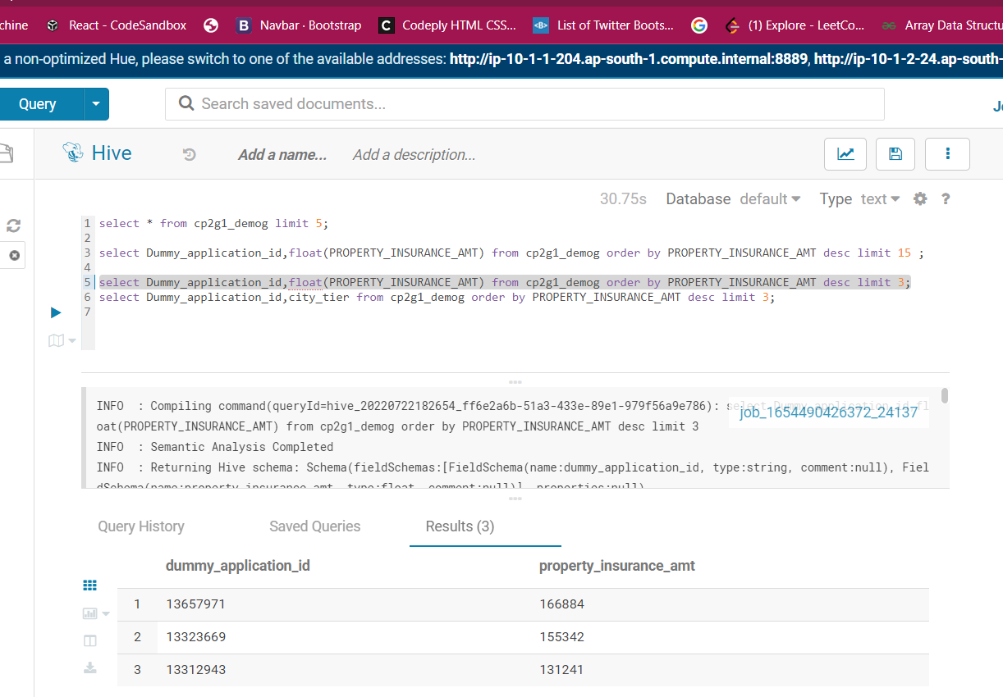
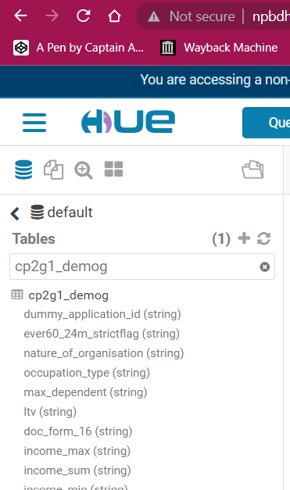
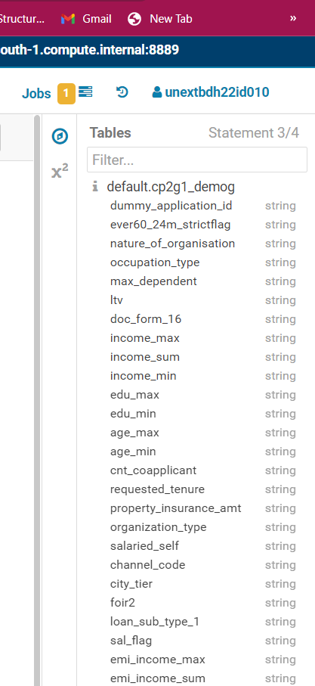
Querying in HQL to check data migrated properly

Slide 11
Why Data Profiling and what it should address???
Better data quality and credibility
Predictive decision making
Pattern matching: What patterns are matched by data values of an attribute?
Completeness: How complete is the data? What percentage of records has missing or null values?
Basic statistics: The mean, standard deviation, minimum, maximum for numerical attributes.
Correlation: What is the correlation between two given attributes?

Slide 12
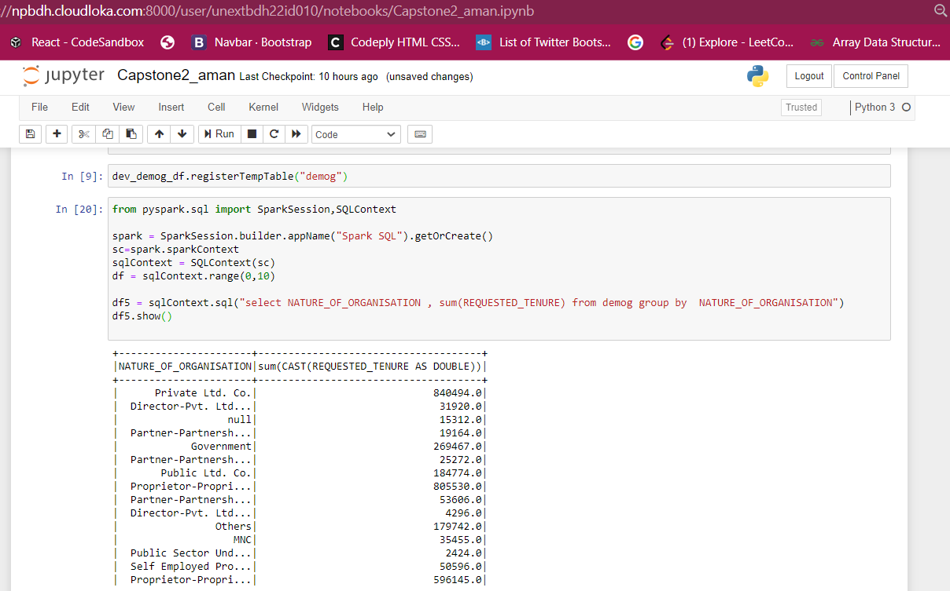
Group By queries on Temp Table

Slide 13
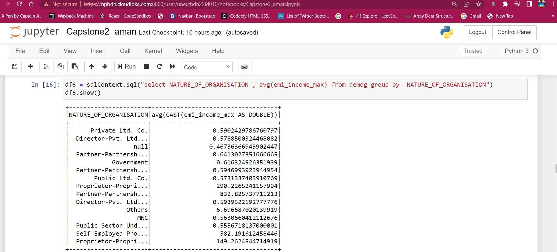
Group By queries on Temp Table

Slide 14
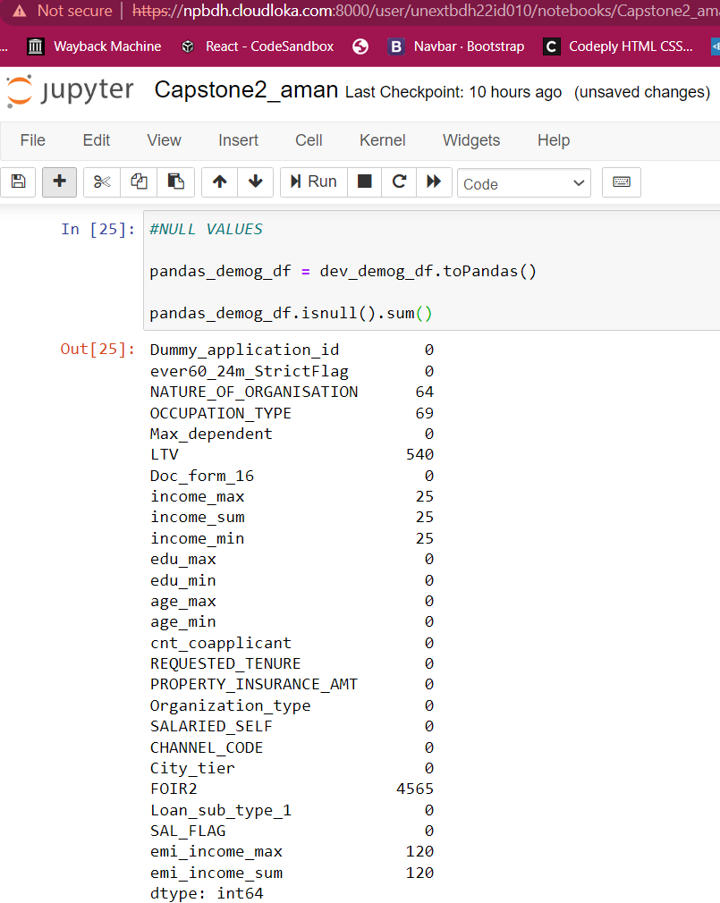
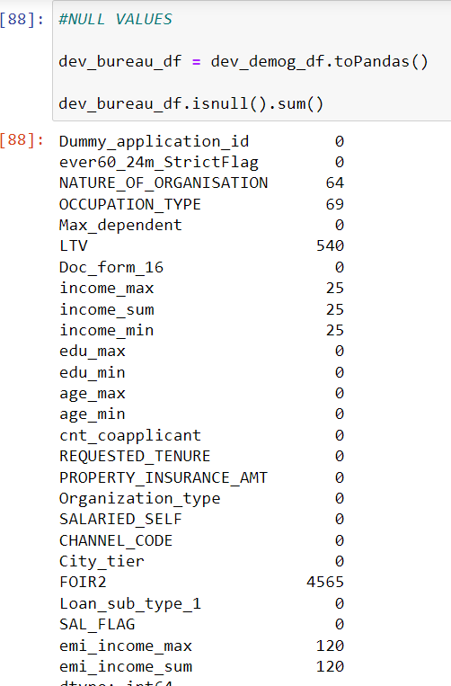
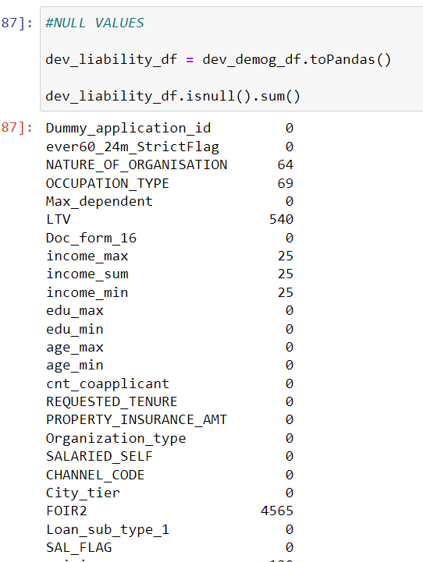
Checking Completeness of the dataset

Slide 15
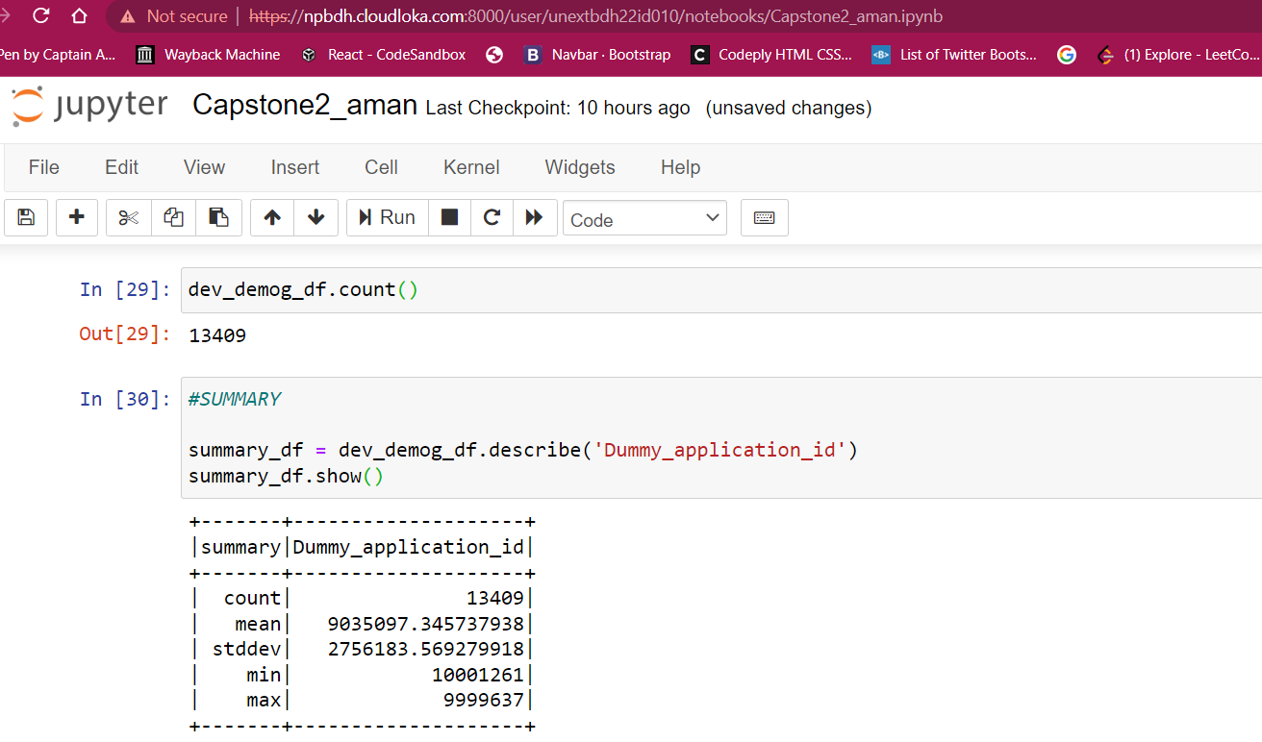
Quering in Spark SQL to analyze basic stats

Slide 16
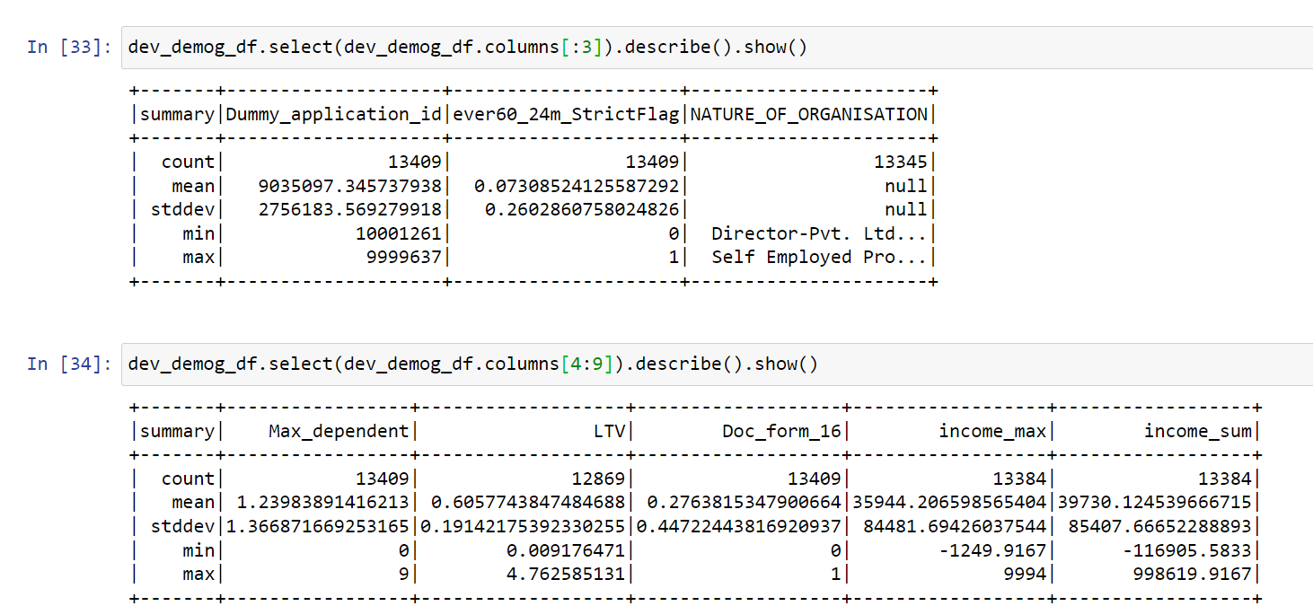
Quering in Spark SQL to analyze basic stats

Slide 17
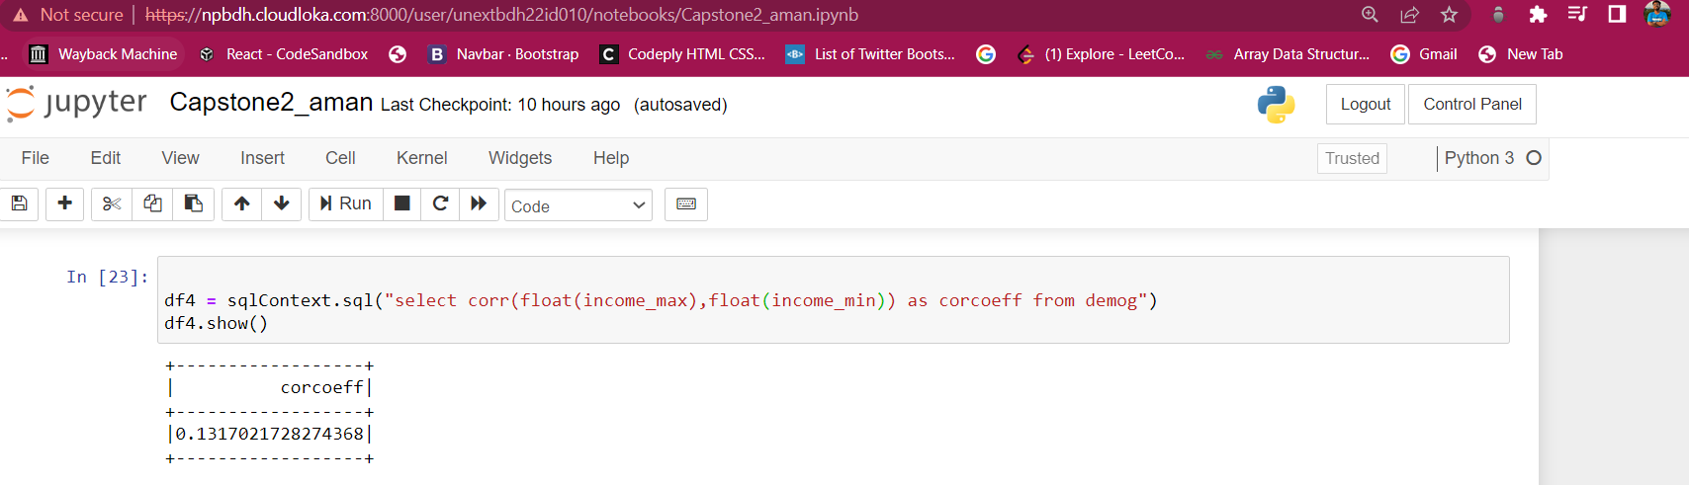
Finding Co-Relation using Spark Sql

Slide 18
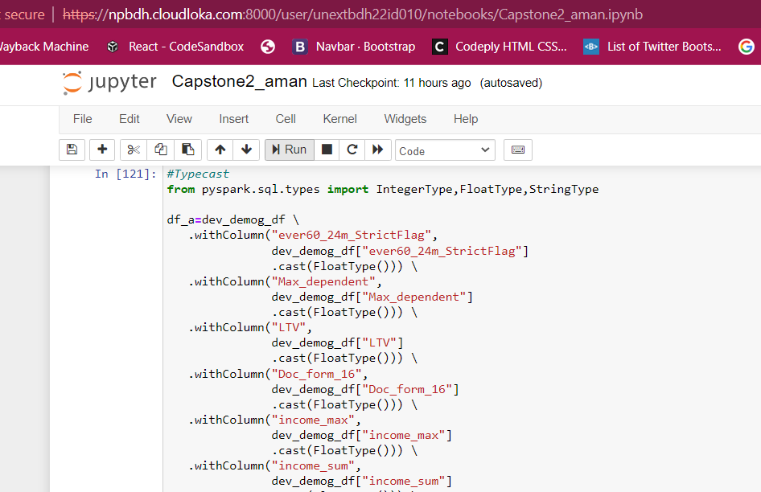
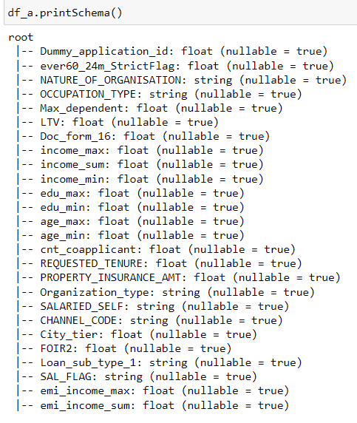
Cleansing Data in PySpark

Slide 19
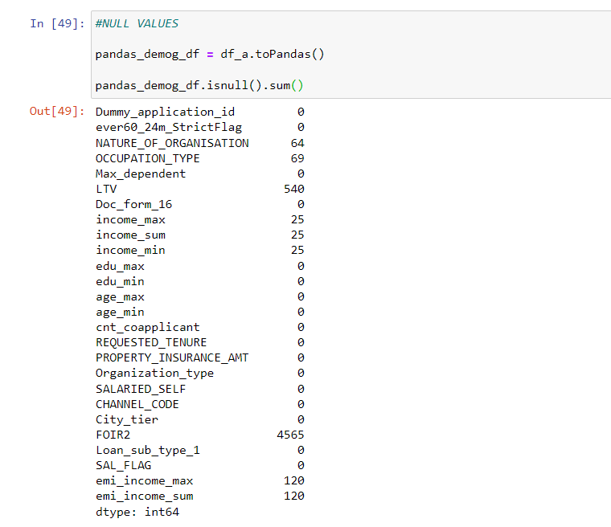
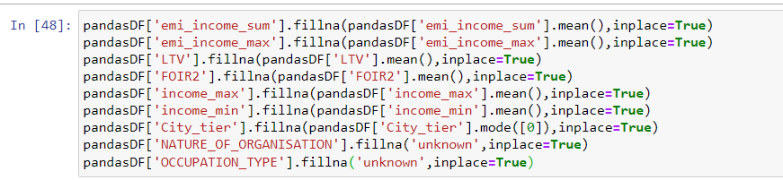
Reading and Treating Null Values

Slide 20
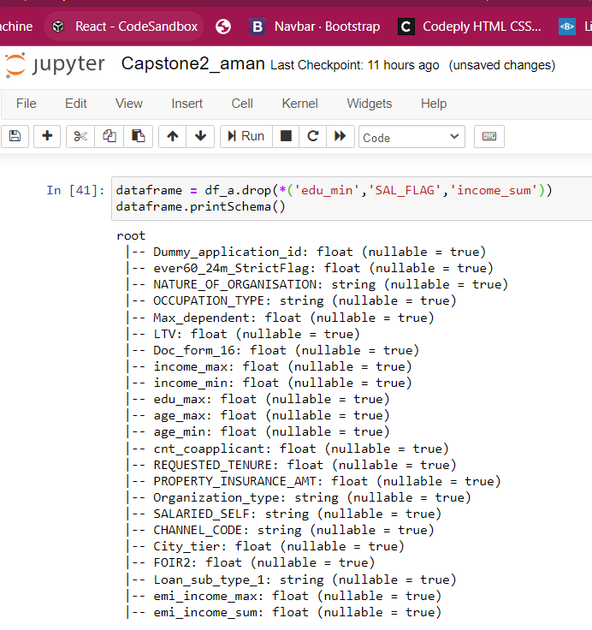
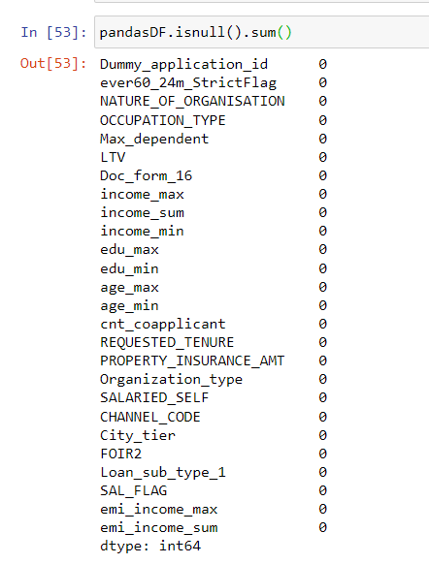
Dropping unnecessary columns

Slide 21
Spark Mlib
Machine learning is a way to educate the computer to make the correct decision based on data feed
Apache Spark MLlib is the Machine learning (ML) library of Apache Spark architecture and one of the major components of Spark.

Slide 22
Types of Machine Learning Algorithm
Supervised Learning
Some famous algorithms
Classification,Regression
Unsupervised Learning
K means clustering
Linear Regression
K-nearest Neignbor
Logistic Regression
Dimensional Reduction,Clustering
Reinforced Learning
Gaming,Finance Sector ,Inventory Management

Slide 23
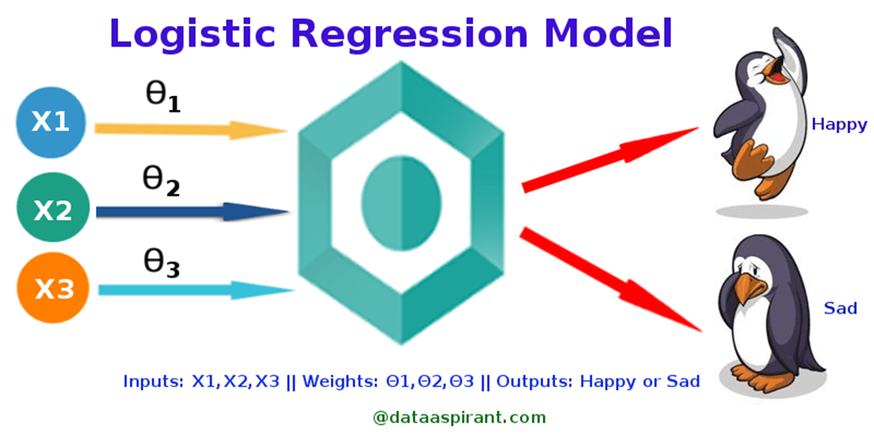
Logistic Regression
Logistic regression is a classification algorithm. It is used to predict a binary outcome based on a set of independent variables.
A binary outcome is one where there are only two possible scenarios—either the event happens (1) or it does not happen (0). Independent variables are those variables or factors which may influence the outcome

Slide 24
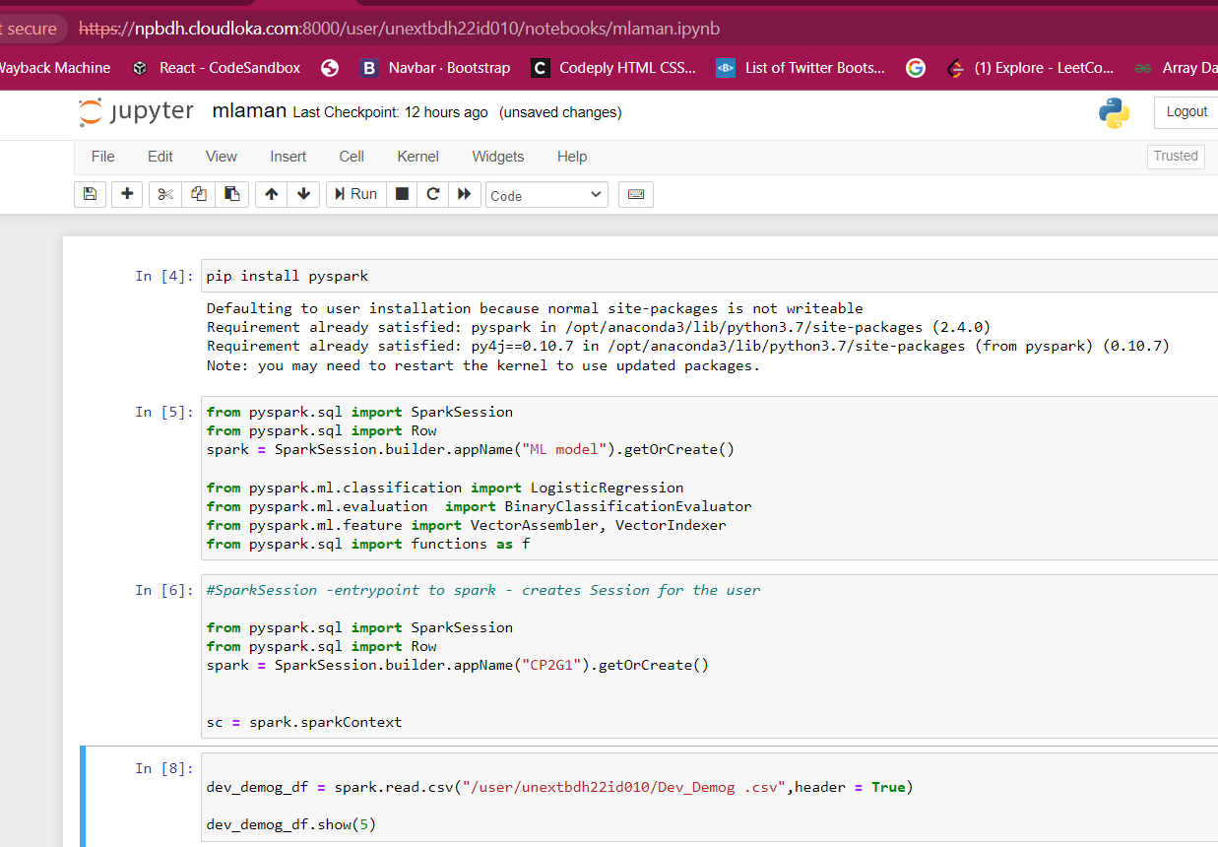
Creating a Spark session and Inserting Demog dataset

Slide 25
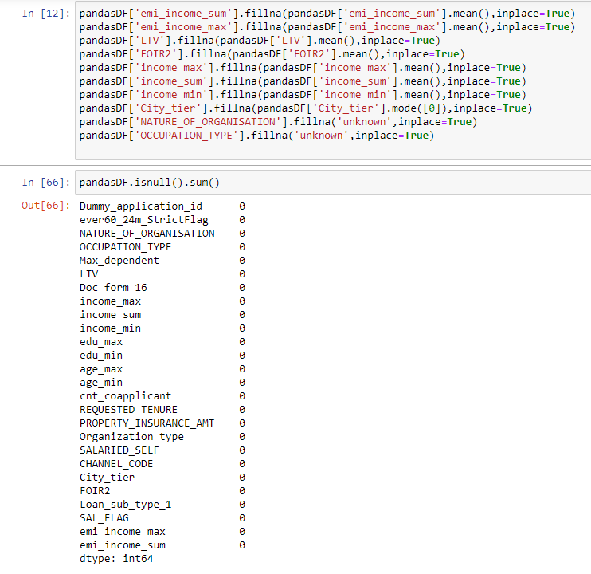
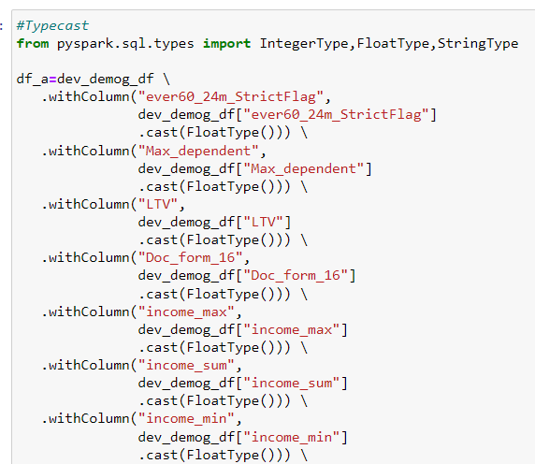
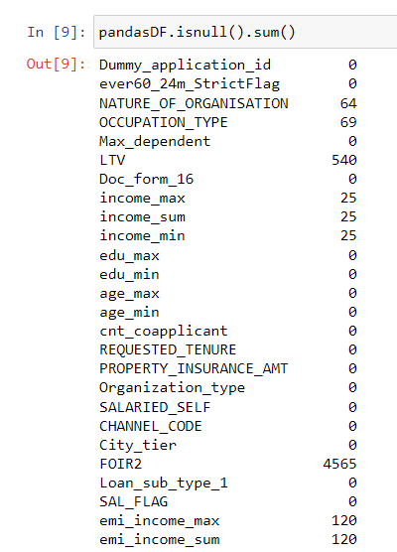
Preprocessing of Data before model building

Slide 26
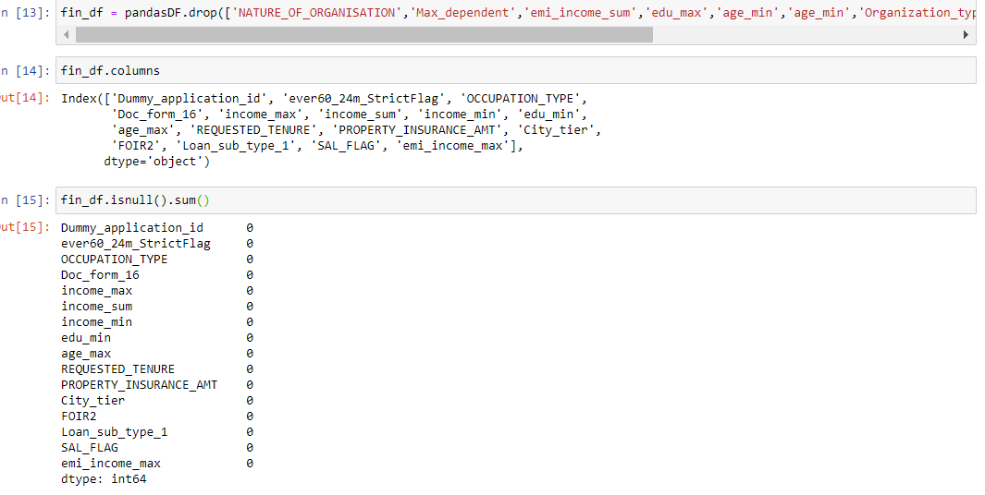
Last level in pre processing

Slide 27
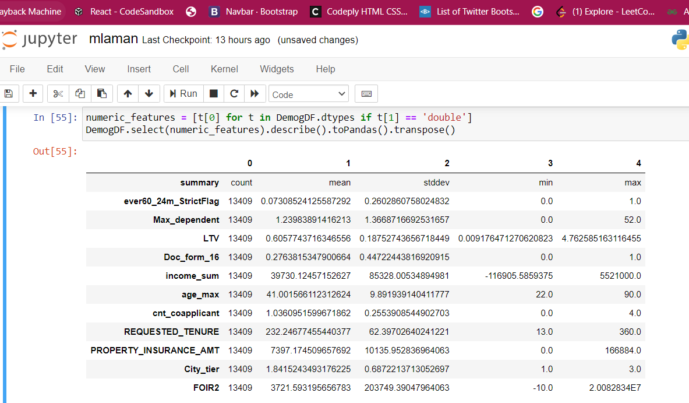
Summarizing the demog dataset

Slide 28
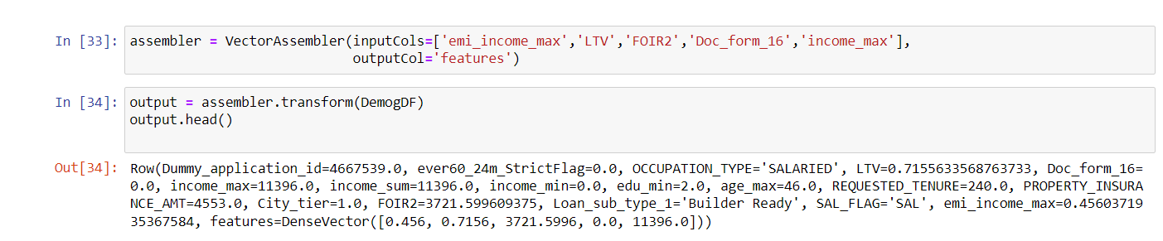
Differentiation colums of dataframe
Dividing the columns of my data set into two varibles to assign the dependent and independent columns using Vector Assembler

Slide 29
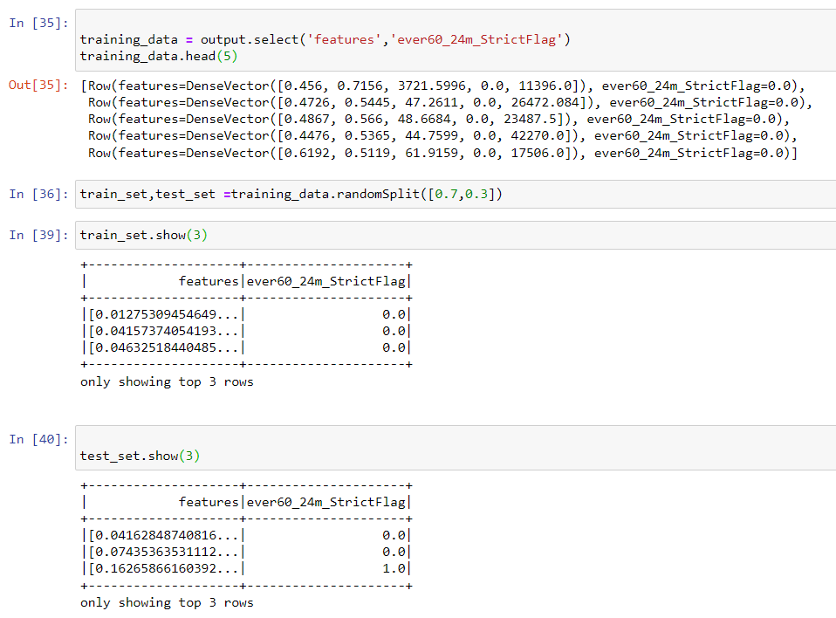
Dividing dataset to train and test my ML model

Slide 30
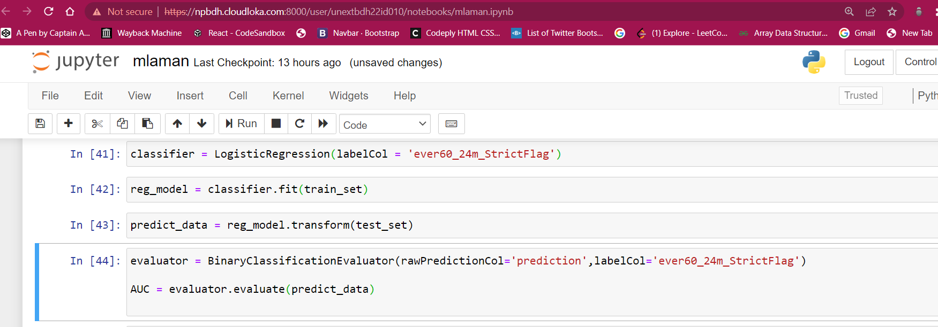
Building and Evaluating Model

Slide 31
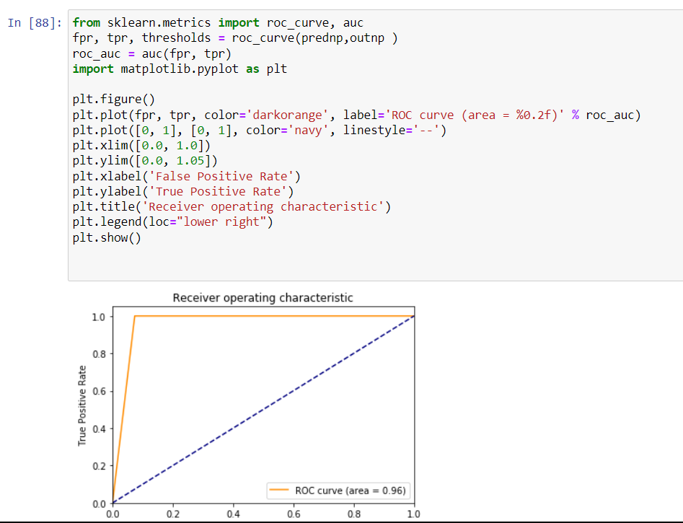
Building and Evaluating Model

Slide 32
THANKS!

